Slide 1
Using the Blackboard Mass Notification System (also know as: BB Comms, Parentlink, Connect 5i)
SENDING A MESSAGE

Slide 2
Help Me !
Michael Goodill, EDUCATOR: District Webmaster Cleveland Metropolitan School District 1111 Superior Avenue E Cleveland, Ohio 44114 Michael.Goodill@clevelandmetroschools.org
Office: 216.838.0095 Cell: 216.534.4950
Luigi Minghetti, Account Manager
Blackboard
Luigi.Minghetti@blackboard.com
Cell: 513-801-1789
For now, only for Emergency Message
Parent Link / Connect 5i: 800-829-8107, support@parentlink.net,
bbcommssupport@blackboard.com

Slide 3
Sending Messages Help
Below our links to the Blackboard Support Pages and Help
Sending a message video
Sending a message help
Choosing Recipients
Changing Start Time
Message Reports
Sending Messages Via the Blackboard HQ App
Advanced Message Options
Help within BB Comms

Slide 4
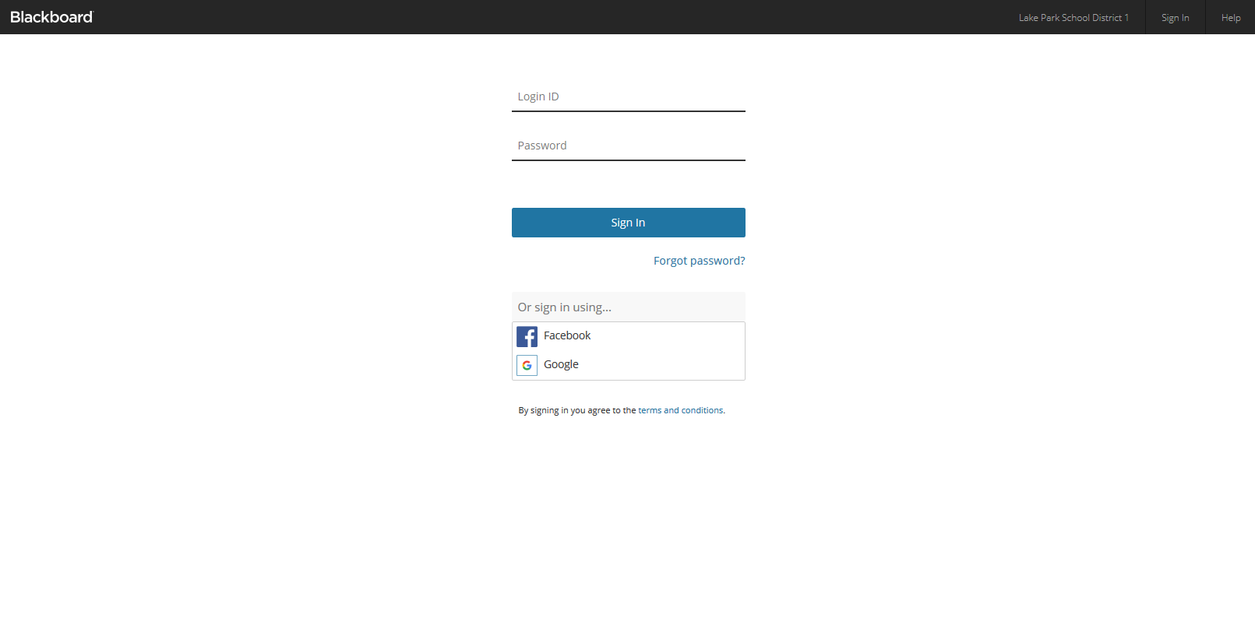
Getting Started
Pull up your Districts Blackboard Mass Notification portal; this is your dedicated URL:
TIP: whether on a PC or Mobile Device, bookmark this URL
https://clevelandmetro.parentlink.net

Slide 5
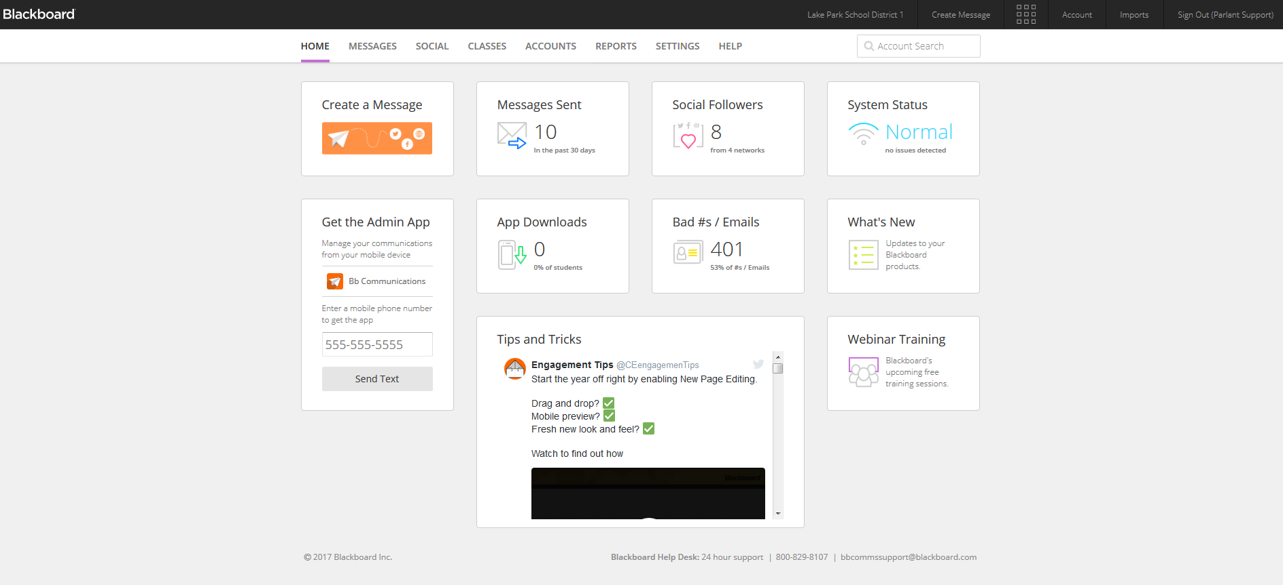
Mass Notification Home Page
Once logged in, you will land on the Mass Notification home page.
On the home page you will see several dashboard items. These dashboards items will depend upon which products you have purchased as part of the Community Engagement suite.

Slide 6
Mass Notification Home Page
Dashboard items may include the following (again dependent upon what your district purchased).
“Create a Message”- Direct link to the Message page
“Messages Sent”- Link to the message tracking report showing messages sent
“Get the Admin App”- Enter your cell phone number and we will text you a link to the Blackboard HQ App , which allows your admins to send their messages via a mobile device on the go
Search for “Cleveland Metropolitan School District”
“Bad #s/Emails”-report displaying bad numbers and emails imported into the Mass Notifications system
“Social Followers”- Used with Blackboard Social Media Manager
“System Status”- Current status of the Mass Notification servers
“App Downloads”- Current number of downloads if you have purchased Blackboard Mobile Communications App
“What's New”-Link to the Blackboard Release Notes page so you can stay up to date with changes and fixes to the product
Note that all the dashboard items will provide more information if you click on them.

Slide 7
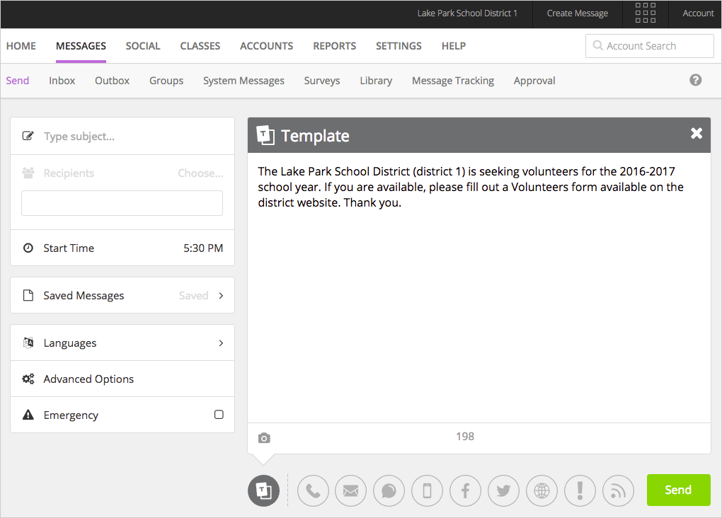
Sending Messages
Sending a message is completed via the Message page. This page is referred to as COPE (Create Once Publish Everywhere).
The COPE page is a simple to use page that allows you to send to multiple delivery methods in a quick concise process. Delivery methods will depend on the products you have purchased as part of your Community Engagement Solutions.
From left to right, phone, email, SMS/Text, Mobile App Push Notifications, Facebook and Twitter posts
DO NOT USE THESE ICONS YET !
For “administrative users” you will have ability to push messages to your website, and to your websites’ On-screen Alerts
Social Media Accounts
have not yet been set up
& are not visible to you

Slide 8
Luigi’s Tips
Do not use these 2 modality icons!
Create a test message to yourself BUT only use the Email, SMS & Phone icons
Like anything, use it to learn it !
Send test messages to your spouse, boyfriend, girlfriend
PLAN – you can create & save messages for upcoming events ahead of time.
Let’s set up some Virtual Screen Share sessions with Luigi (individually or group)

Slide 9
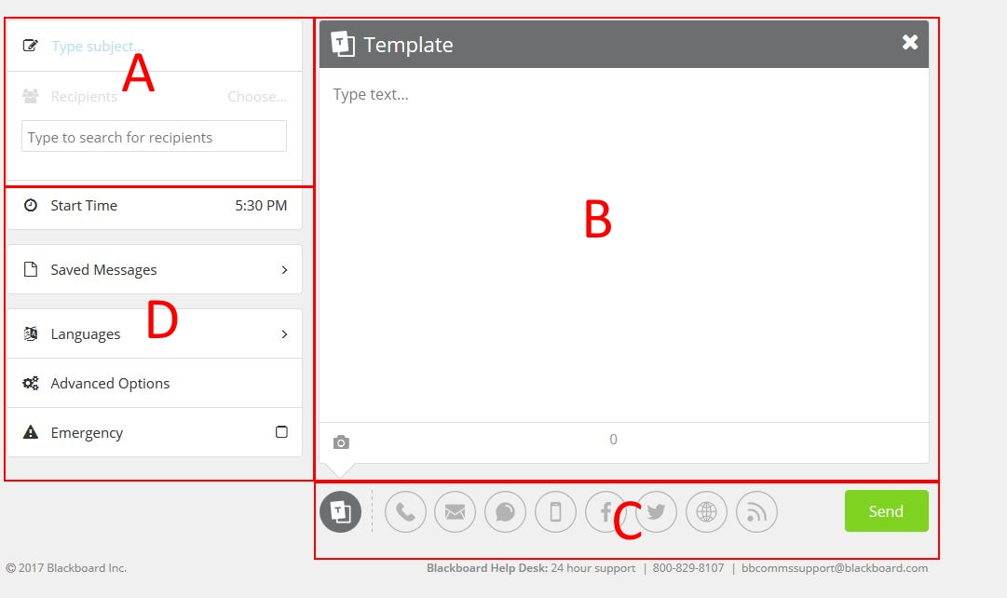
Sending Messages
The COPE message page is made up of 4 sections
The subject line, and recipients
Message template
Delivery methods
Options section

Slide 10
Sending Messages
To send a message, start in section A and enter your subject line of the message, then select the recipients
NOTE: If you are sending messages to your Mobile Communications App you do not need to select recipients.
Next in section B type your message and include any attachments or images associated with your message.
Once your message is created in the template, go to section C and click on each delivery method you want to use.
As you click on them they will go from greyed out to the associated color for that delivery method. Once a delivery method is enabled the message from the template is copied over automatically to that delivery method. You can then customize each method individually.
When the message is complete, you can go to section D and select your delivery time, language, and advanced message options..
When ready hit the send button

