Slide 1
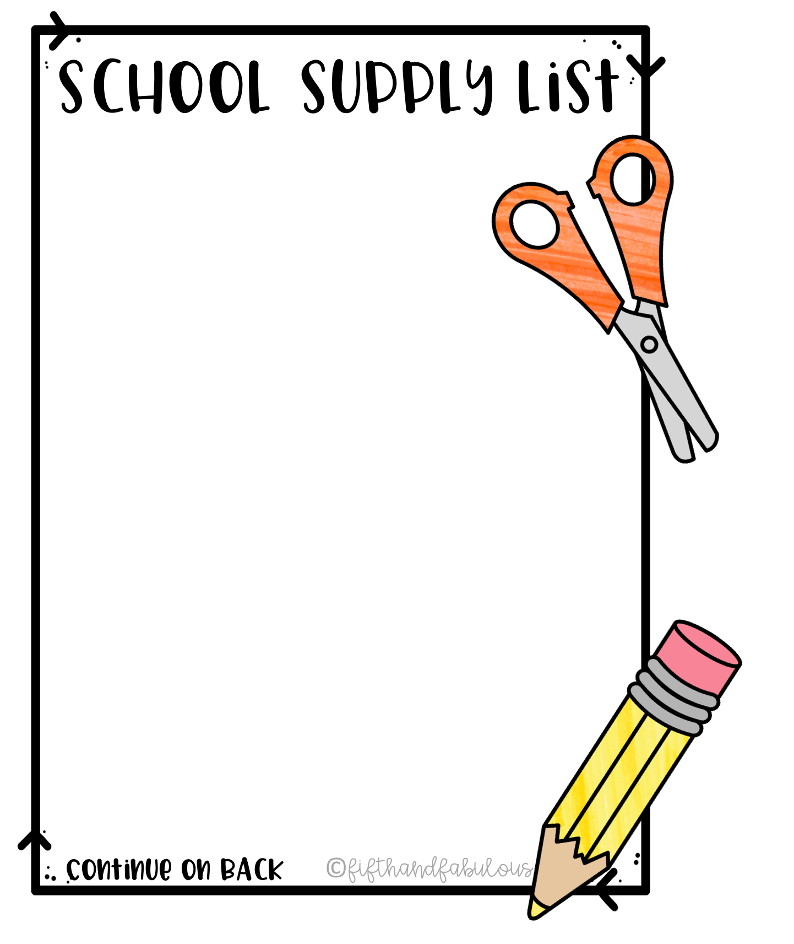
Mary M Bethune PreK-8
1st Grade
24 pack Crayons
2 yellow folders
1 Pair of Headphones (to be kept in classroom)
3 – 24 pack yellow pencils
Backpack
1 pack-colored pencils
3 glue sticks

