Slide 1
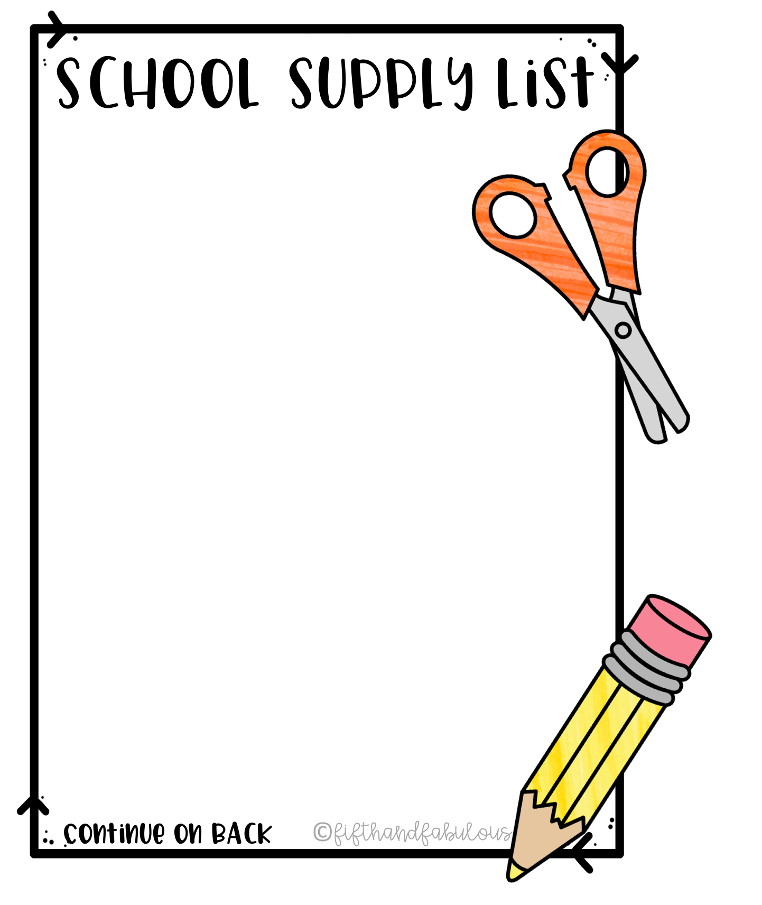
Mary M Bethune PreK-8
Sped 6th-8th Grade
Room 235
2 Boxes Kleenex
2 Rolls Paper Towel
1 Pair of Headphones (to be kept in classroom)
Hand Sanitizer
Backpack
Quart size zip lock bags
Gallon size zip lock bags

