Slide 1
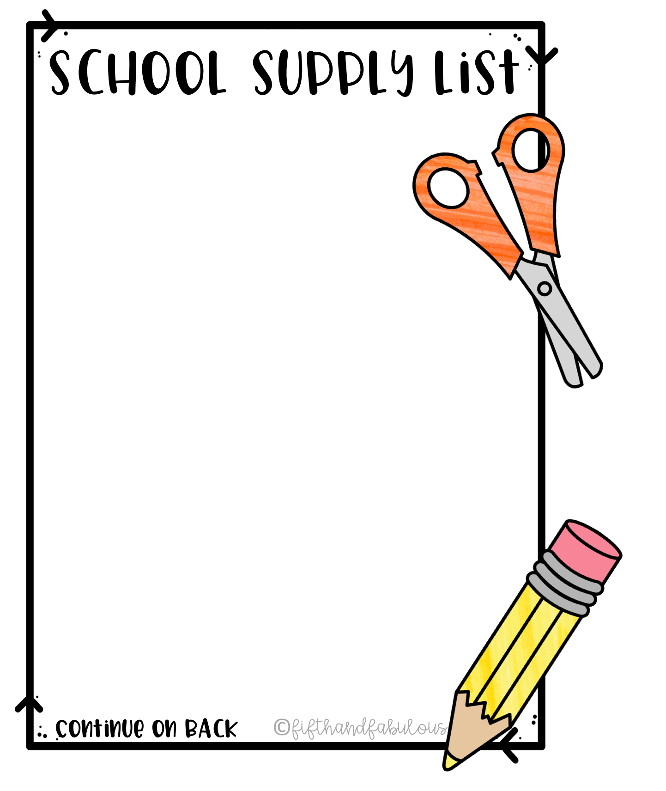
Mary M Bethune PreK-8
3rd Grade
❑ 2 packs of #2 wooden pencils
❑ 2 single-subject notebooks
❑ 5 (2 pocket folders)
❑ 1 pack of crayons
❑ 2 packs of glue sticks
❑ 2 pairs of scissors
❑ 1 box of tissue
❑ 1 bottle of hand sanitizer

