Slide 1
BACK TO SCHOOL
A slide library from your partner in school design.
Notes:
New to PBL?
New to NTN Model?
What to expect for your student this year?
What’s Different for Teachers in a PBL classroom?

Slide 2
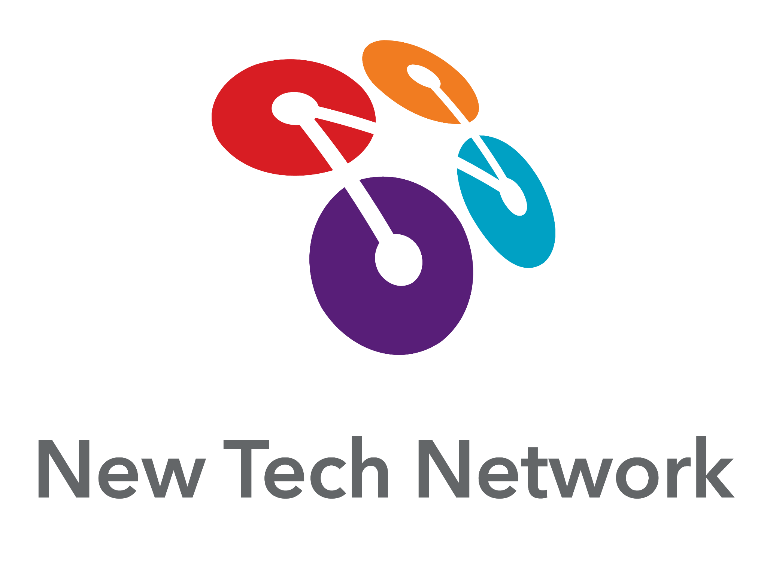
WHY
PROJECT-BASED LEARNING?
The most effective way to develop skills like agency, collaboration, and communication in students is to integrate the practice of each skill in every facet of learning.
Based on our experience, high-quality, relevant project-based learning (PBL) is the best way for students to experience deep, contextual, and shared learning, and acquire and demonstrate proficiency on school-wide learning outcomes.

Slide 3
WHAT IS
PROJECT-BASED LEARNING?
Project-based learning (PBL) is a form of learning that goes beyond simply acquiring knowledge. Students in PBL classrooms learn to apply knowledge while also developing skills that are critical to their future success.
Students in schools with traditional teaching models complete a project to culminate a segment of learning. Students who learn and apply their knowledge through PBL spend their entire learning journey in the process of completing a project. Often times, the projects are interdisciplinary and require collaboration between students.

Slide 4
EVIDENCE OF SUCCESS:
THE NTN MODEL AND PBL
NTN students outperform on state exams across multiple states, subject areas, and grade levels
NTN students made statistically significant gains in critical thinking
NTN students outperform on college entrance exams and workforce readiness assessments
Learn More About NTN’s Evidence of Success in the 2022 Impact Report
© 2023 New Tech Network

Slide 5
DOING PROJECTS VS. PBL
Traditional Unit with Culminating Project
Lecture
Activity
Quiz
Lecture
Activity
Quiz
Review
Exam
Project
Project Based Learning Unit
Project Launch
Activities
Simulations
Creating
Culminating Event and Presentations
B
E
N
C
H
M
A
R
K
R
E
F
L
E
C
T
I
O
N
B
E
N
C
H
M
A
R
K
R
E
F
L
E
C
T
I
O
N
R
E
F
L
E
C
T
I
O
N
Engaging and authentic task designed to provide the context for learning
Workshops
Discussions
Feedback
Lectures
Modeling
Building
Authentic demonstration
of deeper learning
Homework
Reading
Writing
Research
Interviews
Preparing
Labs
Quiz
Drafts
© 2023 New Tech Network

Slide 6
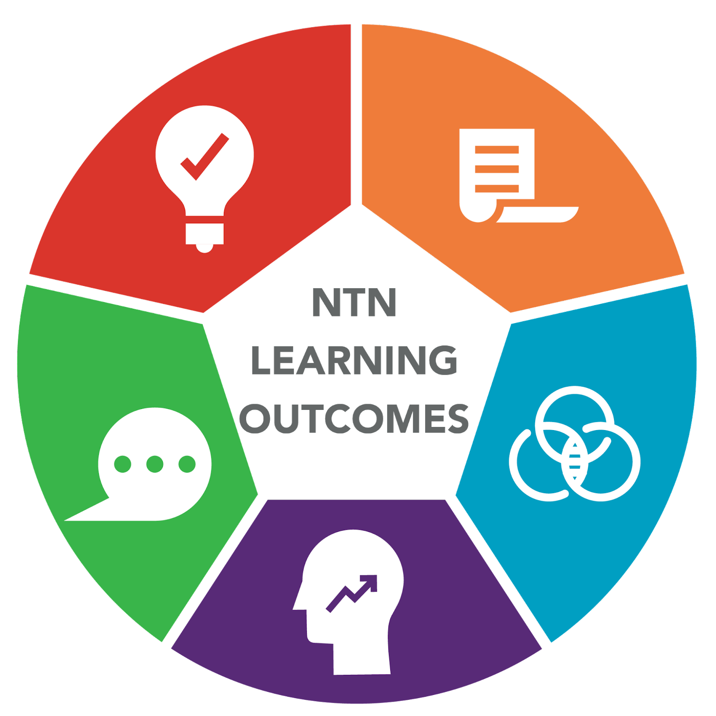
NTN LEARNING OUTCOMES
KNOWLEDGE AND THINKING is the ability to reason, problem-solve, develop sound arguments or decisions, and create new ideas by using appropriate sources and applying the knowledge and skills of a discipline.
COLLABORATION involves a group and individual’s ability to contribute to group tasks. AGENCY is a combination of academic mindsets and the ability to take ownership over one’s learning. ORAL COMMUNICATION involves the ability to communicate knowledge and thinking orally.
WRITTEN COMMUNICATION is the ability to effectively communicate knowledge and thinking through writing by organizing and structuring ideas and using discipline appropriate language and conventions.

Slide 7
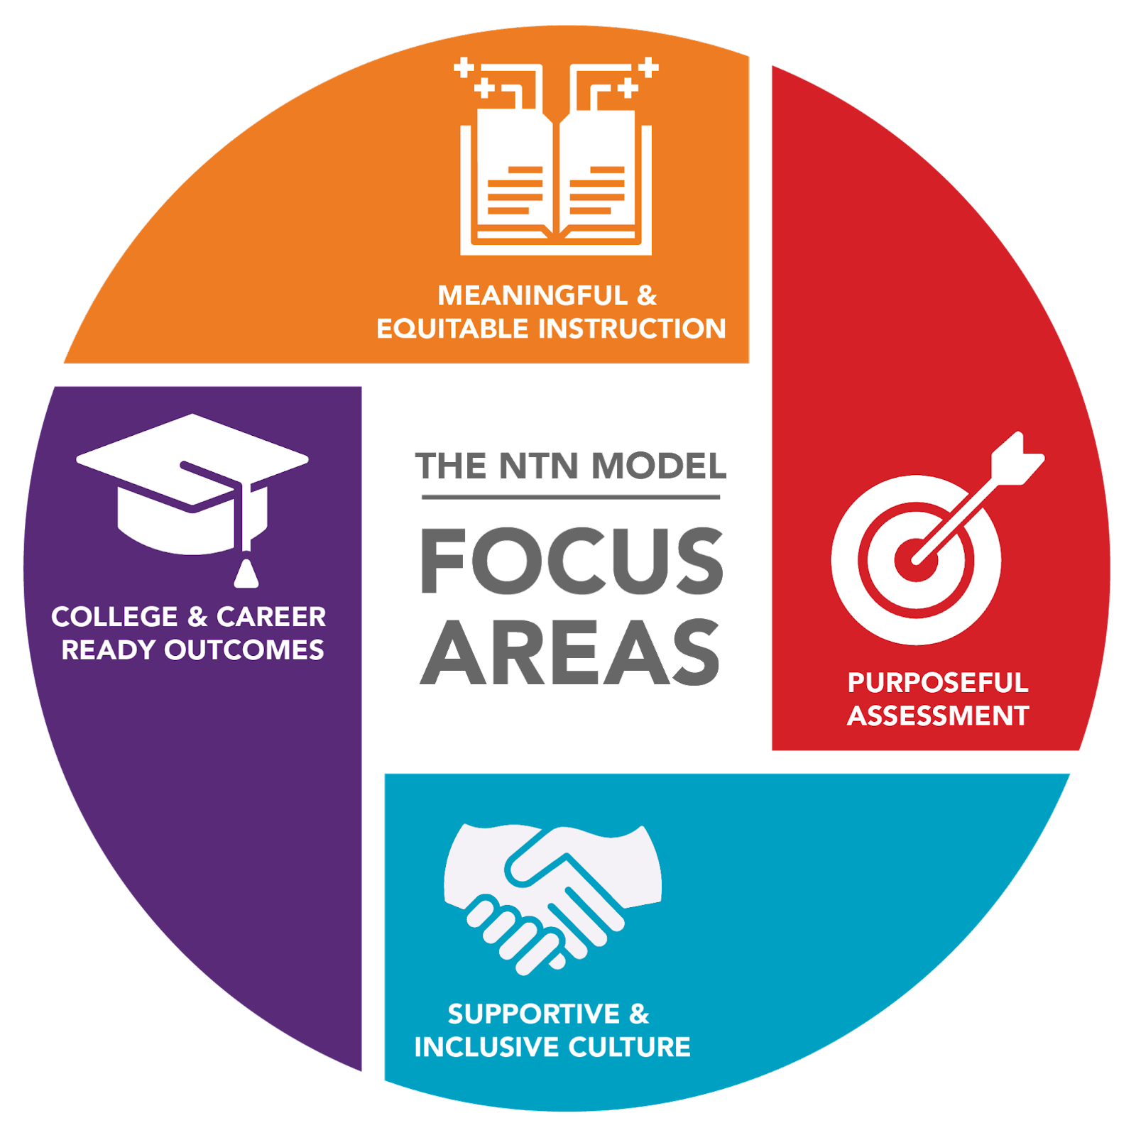
NTN FOCUS AREAS
COLLEGE & CAREER READY OUTCOMES
Prepare each student for postsecondary success with the knowledge, skills, and mindsets to be ready for college and career: Collaboration, Knowledge and Thinking, Written Communication, Oral Communication, and Agency.
SUPPORTIVE & INCLUSIVE CULTURE
Foster a school-wide culture of belonging, care, community, and growth for adults and students. This type of culture helps ensure that students and teachers alike have ownership over the learning experience and school environment.
MEANINGFUL & EQUITABLE INSTRUCTION
Center the instructional approach on authentic, complex thinking, and problem-solving. Based on our experience, high-quality, relevant project-based learning (PBL) is the best way for students to experience deep, contextual, and shared learning and acquire and demonstrate proficiency in college and career ready outcomes.
PURPOSEFUL ASSESSMENT
Cultivate shared, school-wide understandings of equitable, purposeful assessment and grading practices that inform teacher instruction, emphasize individual student growth, and demonstrate progress towards college and career readiness. These include performance assessments for students to demonstrate their learning in age-appropriate ways.

Slide 8
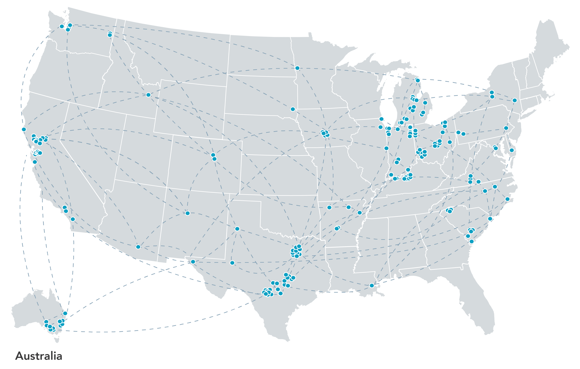
NEW TECH
NETWORK
NTN partner schools succeed because they work together – sharing ideas and results from each of their schools with other NTN communities.
For New Tech Network, this spirit of collaboration stems from a shared vision of changing how students are educated so they are prepared for an ever-changing world.
5,700+
90,000+
219
90,000
TEACHERS
STUDENTS
SCHOOLS
GRADUATES OVER THE PAST 25 YEARS
Learn More About NTN’s Evidence of Success in the 2022 Impact Report

Slide 9
NEW TECH NETWORK
RESEARCH AND EVIDENCE
NTN high school students had a 95% graduation rate
NTN students persist in college at a rate of 82%
NTN project-based learning created an instructional environment that positively impacted student learning, relationships, and technology use.
Compared to the national
Average of 85%.
Compared to 74% nationally.
Learn More About NTN’s Evidence of Success in the 2022 Impact Report

Slide 10
For more information about New Tech Network,
please visit newtechnetwork.org.

