Slide 1
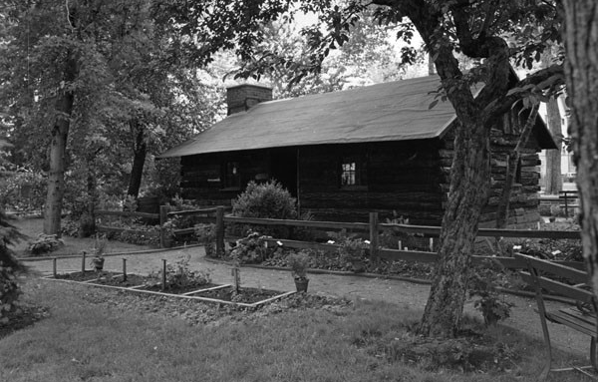
zverina log house project
Kirsten Mahovlich, Flexible Content, Expert-Science, grades 7-12
Terri Wade-Lyles, M. Ed., Flexible Content, Expert-Science, grades preK-8

Slide 2
History

Slide 3
History
Built in 1908
Rumored to be the oldest log structure in Cleveland
Located on East Blvd (MLK), south of 12210 Miles Ave.

Slide 4
Family
Anton Zverina
Bohemian (Czech) immigrants
Prominent businessman
Owned grocery store at E. 55 & Broadway
Pioneered the processing of chicory to be used as a coffee substitute
Owned rye flour mill & bakery
Built the log house to be used as a playhouse for his five children
Hosted holiday gatherings, picnics, and community meetings

Slide 5
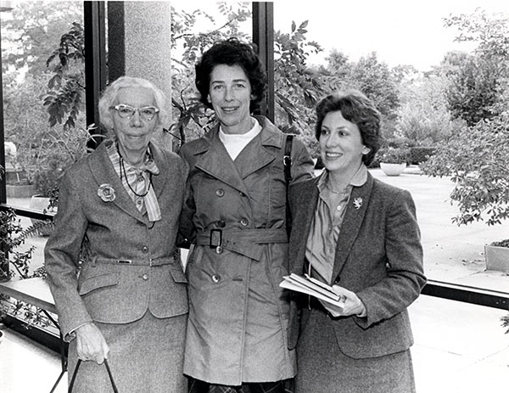
Frances Zverina
Dedicated educator
Member of the Herb Society of America
Donated the property to Cleveland Public Schools in 1962

Slide 6
With CMSD (1962-1979)
Nationally recognized Horticulture program
Decided to add an Herb Garden to the property
Designed by Henry L. Pree
Featured rare herbs and trees collected by Jack Durell & Nick Paserk, a wishing well, water features, and a sundial
Special experience for students to touch, feel, and taste the herbs
Widely visited and highly praised
Featured at the 1964 Home & Garden Show

Slide 7
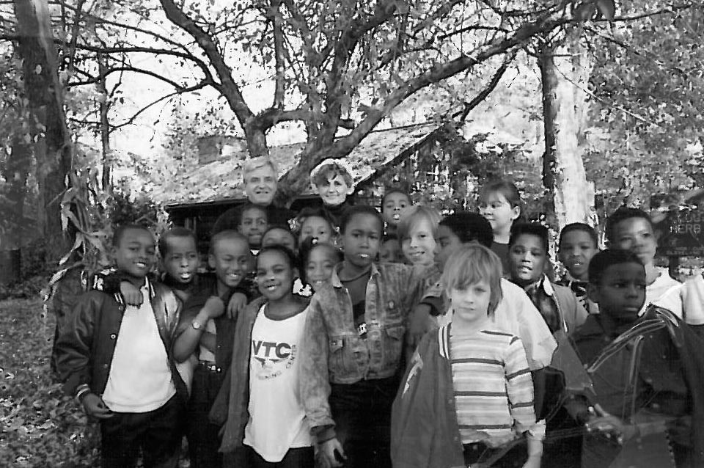
Shaffer Memorial (1981-1991)
Under the direction of Reverend Ralph Fotia & Sandra Vodanoff, the Log House was revived into a community meeting place
Hosted Thanksgiving dinners, quilting bees, holiday celebrations, weddings
Designated a Cleveland Landmark in 1983

Slide 8
Today

Slide 9
Cleveland Botanical Garden: Green Corps 2012

Slide 10
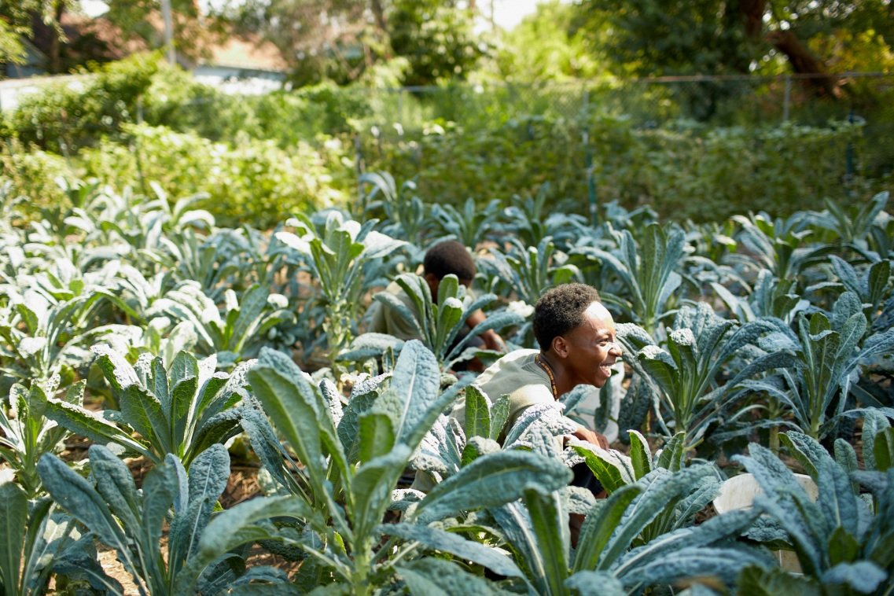
Cleveland Botanical Garden: Green Corps 2012
New Logo and Brochure
94 Youth in Green Corps (Winter and Summer program)
13,256 lbs. of food harvested
Curriculum Revisions underway
Winter Program (January – May)
Partnership with Tri-C
3 early college credit hours
77 applicants for 25 positions
Community Oriented Initiatives
Orchard Planting
Workshops
Events
Farms Stands
Garden Plots

Slide 11
Washington Park

Slide 12
Washington Park
Re-establish Garden Site
Site clean-up
Student participation with Community
Student community service
Recognition of students accomplishments
Integrate Academic & CTE Horticulture Standards
Use design process
Co-ordinate standard based lessons for Horticulture, Math, & Science
Utilize landscape principles & practices
Improve end of course outcomes
Implement design
Hands-on experience
Preparation for future working site
Co-ordinate future activities with community, support, & publicity

Slide 13
Union Miles

Slide 14
Organizational History
Founded in 1981, Spin off organization for the Union Miles Community Coalition
Community Action Group, comprised or residents, businesses and churches
Housing critical to long term vitality of the Community
Complemented its Housing Focus with Community Organizing Programs
Long History of Community Organizing

Slide 15
Union Miles Today
Over The Years:
Owed and operated the Cermack Building
Developed Garret A. Morgan Place & JP Green Project
Miles Plaza, which we followed with Miles Point Crossing
Currently own and manage 120 lease purchase homes
Historic Renovation of Miles Park Carnegie Library
Partnership with CMHA to construct two Senior Apartment Buildings

Slide 16
Program Offering/Outreach
Code enforcement
Weatherization Programs- Housewarming and Electric Partnership Program
Financial Literacy
Quarterly Ministers Brunch
Leadership/Community Meetings
Staffing Street Clubs

Slide 17
Vision for Log Cabin
Partnership with CMSD preserve community asset
Element of UMDCs Streetscape Plan
CMSD To Utilize Asset
Add Historic and Sustainability Curriculum
Potential Use: Three Season Classroom
Source of Youth Employment in Summer Months
Timeframe for completion 2 years

Slide 18
CMSD Vision
Link visions together
Breakout Sessions for Subcommittees

Slide 19
Clean Up Day
Earth Day 2013 (April 20th)

Slide 20
Partner List

Slide 21
THANK YOU!

