Slide 1
Procedures for Third Grade
This is how we do it!

Slide 2
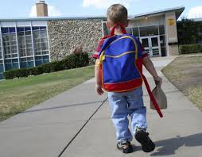
What do I do when I get to school?
Go directly to the cafeteria.
If you want to eat breakfast, get in line and get a breakfast. Sit down and eat.
If you don’t want to eat, sit down and talk quietly with a friend.
Wait for your teacher to come to the cafeteria to get you.

Slide 3
How to enter the classroom…
Enter the room quietly and politely.
Go directly to your desk and take down your chair.
Empty your book bag of all important things.
Go to your cubby and hang up your book bag and coat.
Return to your seat and open your planner to today’s date.
Put your Cold Reads in the corner of your desk and put your homework in the Turn in Bin.

Slide 4
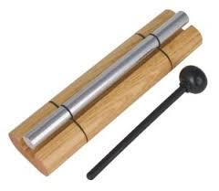
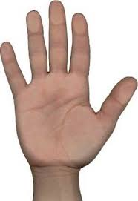
Quiet Signals…
Hand up
Chime
Count down

Slide 5
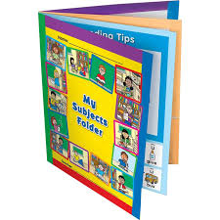
Organizing Supplies…
Subject folders
Only pencils, eraser, highlighter, dry-erase maker, and dry erase eraser in your pencil pouch. NO exceptions!
Crayons, scissors and glue should be in a separate supply box/bag.

Slide 6
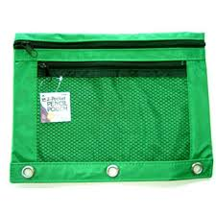
Pencil Pouches
Every Monday, you will get your pencil pouch returned for the week.
Your pencil pouch has 10 pencils for you to use all week.
If you still have 10 pencils by the end of the week, you will get a coupon to turn in to receive a treat.
If you don’t have 10 pencils, you can try again the following week to get a treat.
If you lose your pencil pouch, you are responsible for buying a new one. ($1)
Be a friend of pencils!

Slide 7
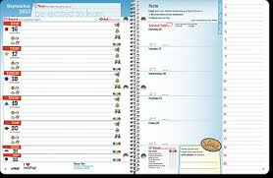
Planners
Your planner is an important tool for you to use in the third grade.
You are responsible for filling out your planner daily.
If your planner isn’t filled out, you will have a consequence.
Your planner MUST BE signed by an adult daily.
Your planner must be returned daily.

Slide 8
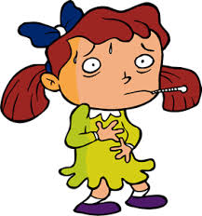
If you are absent…
If you are absent from school, you are still responsible for making up the work you missed.
You are responsible for taking home your Absent Folder and returning it.
Your parent needs to write a note when you are absent.
Always come to school unless you are sick.

Slide 9
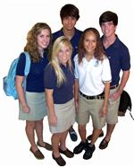
Dress Code
We do have a dress code at Orchard S. T. E. M. School and the dress code must be followed.
If you are not in dress code, you will be given dress code clothes to wear for the day.

Slide 10
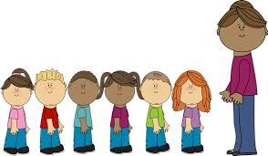
Lining up…
Stand up quietly and push in your chair.
Take all necessary items for where ever it is you are going.
Take your place in line without touching others or talking.
Face the front of the line.
Watch where you are going!

Slide 11
If you need to leave the room…
Ask permission.
Take a pass.
No running or playing.
Return quickly.

Slide 12
When an adult enters the room…

Slide 13
Homework
Homework will be given each night. Over the weekend, you will be expected toread your poetry binder and get it signed.
Homework is to be done BY YOU, the student.
A parent or a homework helper may help you but you are to do the writing.
Homework is due the following day.

Slide 15
Homework

Slide 16
What to do with your work…
If you are done with an assignment, make sure y
Place it in the “Turn-In-Bin”.
If you are still working on an assignment, put it in your subject folder in the correct pouch.

Slide 17
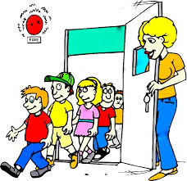
Fire Drills
Exit the room to the main stairwell.
The last one out, closes the door.
Go quickly and quietly.
No running.
When you get to the bottom of the stairs, exit through the door.
Go through the playground to the fence and go right.
Stand quietly until the “all clear” bell rings.

Slide 18
Homework Expectations
The following is what you will do each night:
A worksheet with written homework; one side reading, one side math.
Cold Read-a Cold Read is a reading passage that your child will read throughout the week. The goal is to increase accuracy and fluency. Thee child should read the entire passage out loud to an adult EVERY night. Encourge your child to read smoothly and to pay attention to punctuation. Cold Read must be signed daily.
Study spelling words each night.
Read your book in a bag for 15 minutes.

Slide 19
Morning Meeting
Morning Meetings will be held each morning.
Read the Morning Message each day.
Complete the task if there is one.

Slide 20
Restroom Procedures
We use the restroom together as a class twice a day.
You are responsible for using the restroom with the class.
If you have an emergency, put up the signal. I will nod my head if it’s okay for you to go. You may leave quietly. Do not play. Return to class before 2 minutes is up.
If I shake my head, you need to wait a
few minutes.

Slide 21
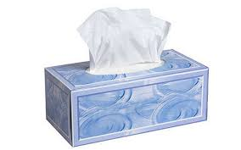
What if I need a tissue?
You may get up and get a tissue from the nearest box of tissue whenever you need one.
Go to your seat and put the tissue in the waste can when there’s a break.

Slide 22
Supplies you will need…
2 boxes of Crayola crayons 24 count
1 bottle of glue
3 marble composition notebooks
2 spirals notebooks
1 inch binder
sturdy book bag
1 pair of scissors
1 pack of 12 pencils
2 dry erase markers
2 highlighters
1 red ball point pen
Girls-1 box of tissue
Boys-1 roll of paper towels

Slide 23
Ending the day…
Have your planner, homework folder, and your book-in-a-bag on your desk.
Wait to be called to get your book bag.
Pack up your book bag.
Stack your chair.
Get in line.
Stand quietly.

