Slide 1
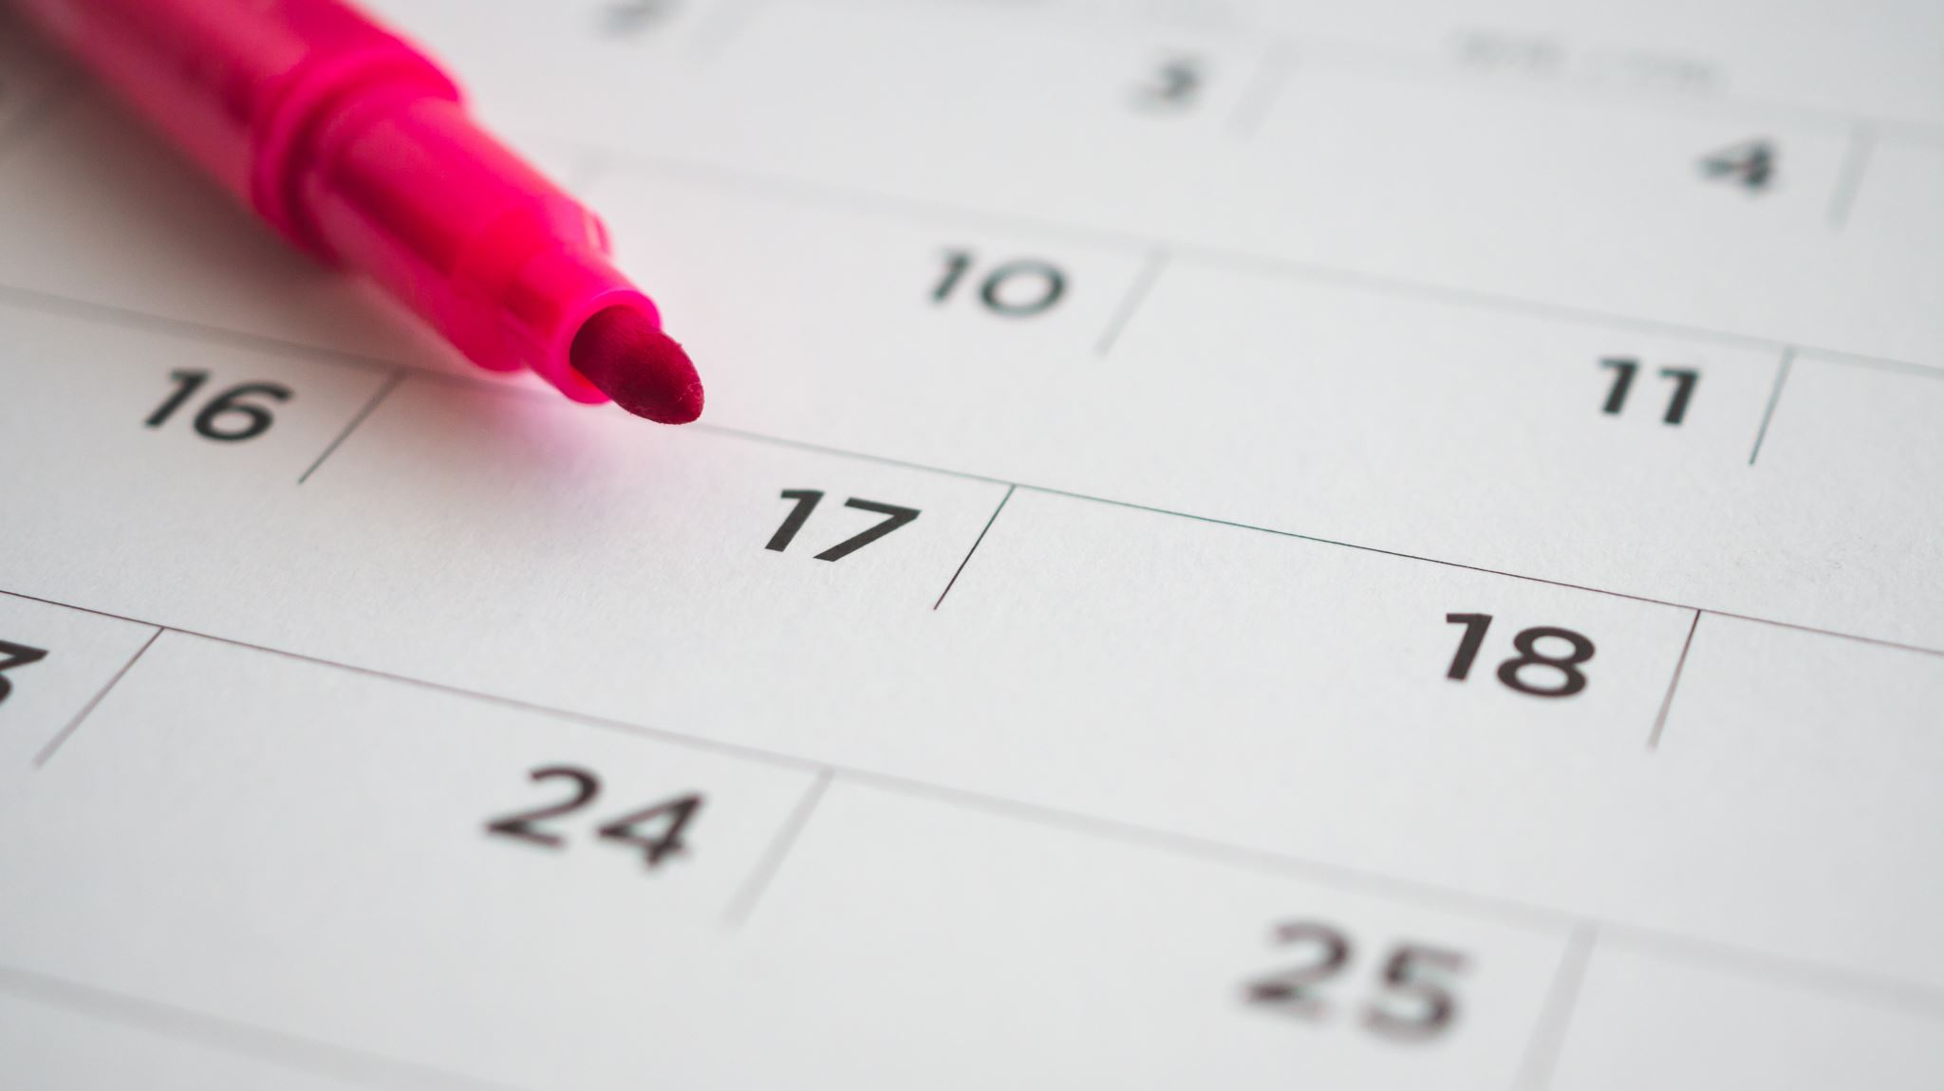
KCBLA September Attendance

Slide 2
September Attendance Results
Grade Level | Class Percent | Number of Scholars with Perfect Attendance
K | 93% | 6
1st | 89% | 4
2nd | 97% | 5
3rd | 88% | 6
4th | 97% | 6
5th | 97% | 9
6th | 94% | 8
7th | 82% | 2
8th | 97% | 12

Slide 3
Kindergarten Students with Perfect Attendance for September
Grandiose Allen
Josiah Benefield
Kiyan Gibson
Monroe Parker
Royston Smith Jr.
Tristen Wallace Jr.

Slide 4
First Grade Students with Perfect Attendance for September
Makhai Carter
Josaiah Chin Gonzalez
Greysen Fountain
Legend Wall

Slide 5
2nd Grade Students with Perfect Attendance for September
Yusuf Abdul-Hakim
Tywan Al’amin
Marcus Ali
Naeem Wakeel
De’Brian Willis

Slide 6
3rd Grade Students with Perfect Attendance for September
Esa Abdul-Hakim
Kameron Dawson
Cyrie Frazier
Carson Jester
Sevhyn McKnight
Mar’Lyon Sawyer

Slide 7
4th Grade Students with Perfect Attendance for September
Breylin Frazier
Hunter Laughlin
Jonathan Morgan
Kingston Reed
Mar’Lowe Sawyer
Noah Taylor

Slide 8
5th Grade Students with Perfect Attendance for September
Rayvon Anderson
Justice Craddock
Royal Green
Robert Johnson
Timothy Kaseda-Williams
Titus Morton
Sulieman Ndahayo
Maceion Porter
Robert Walden

Slide 9
6th Grade Students with Perfect Attendance for September
Charles Gibson
Webster Hamilton
Zachary Laughlin
Jaymar Mitchell
Tyrique Outlaw-Davis
Anthony Patton
Casey Williams
Charles Woods Jr.

Slide 10
7th Grade Students with Perfect Attendance for September
Elijah Burrows
Kam’ron Nelson

Slide 11
8th Grade Students with Perfect Attendance for September
Camryn Bethea
Lamar Carter
De’mari Crayton
Amir Gambrell
Jamir Hale
Cayden Jenkins
Martin Libuit
Mark McCoy
Elijah Outlaw
Markus Penn
Elijah Steel

