Slide 1
Recommended by Raquel C. White, Peer Coach
Teaching with Plickers

Slide 2
Getting Started

Slide 3
Getting Started
1
2
3
4
5
6
7
8
What is Plickers?
How is Plickers Used?
Download the App
Print Your Cards
Add Your Class
Creating Questions
Scan Responses
View Results

Slide 4
What is Plickers?
Plickers (Paper Clickers), is a real-time assessment tool that let’s you poll your class without the need for student devices.
Scanning student cards with the Plickers app, teachers get instant feedback on their lessons.
Both interactive and anonymous, Plickers is an activity students enjoy and feel comfortable participating in.

Slide 5
How is Plickers Used?
Found in classrooms K-12 to University, all ages, all subjects.
Often used for formative assessment.
Great for warm-ups, exit tickets, lesson refreshers.
Outside the classroom, used in interactive settings such as physical education and professional development.

Slide 6
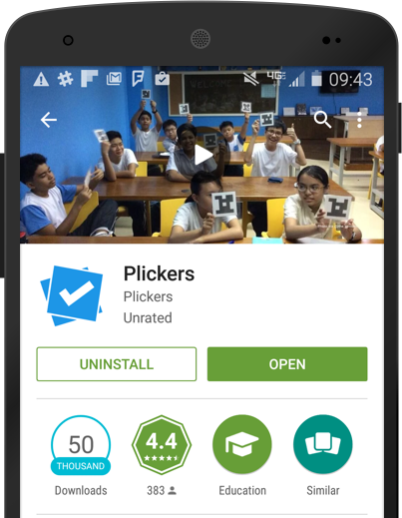
Download the App

Slide 7
Download the App
In order to scan students' responses, you must have the Plickers mobile app installed.
Plickers is available for free on both the Google Play Store and the iOS App Store.
Only the teacher needs the Plickers App. Students don’t need to download a thing!
For the iPad, filter by "iPhone only" and search for Plickers in the App store.

Slide 8
Print Your Cards

Slide 9
Print Your Cards
Print out your cards from plickers.com/cards or purchase a set on Amazon.com.
Each card has a unique number that can be assigned to individual students.
Each side represents an answer choice.

Slide 10
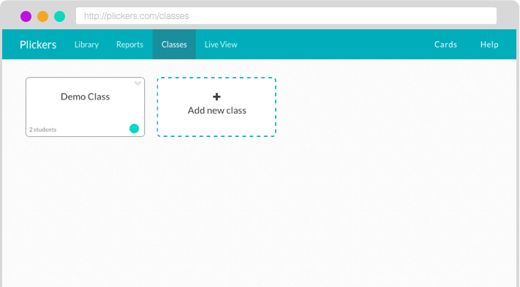
Add Your Class

Slide 11
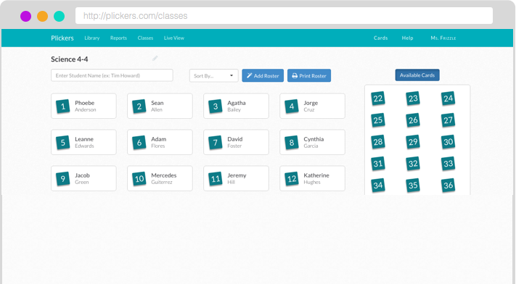
Add Your Class
Add classes and students through the Plickers website on the Classes page.
Plickers automatically assigns card numbers to students as you enter their names.
Add up to 63 students per class.

Slide 12
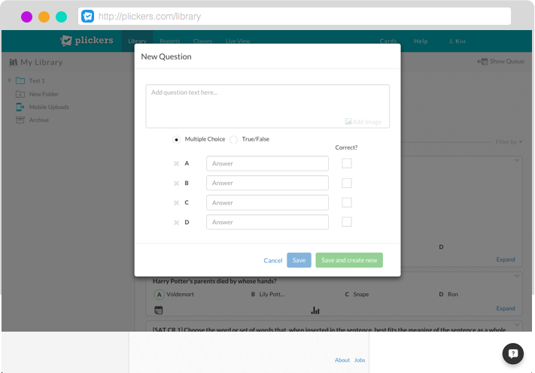
Add Your Questions

Slide 13
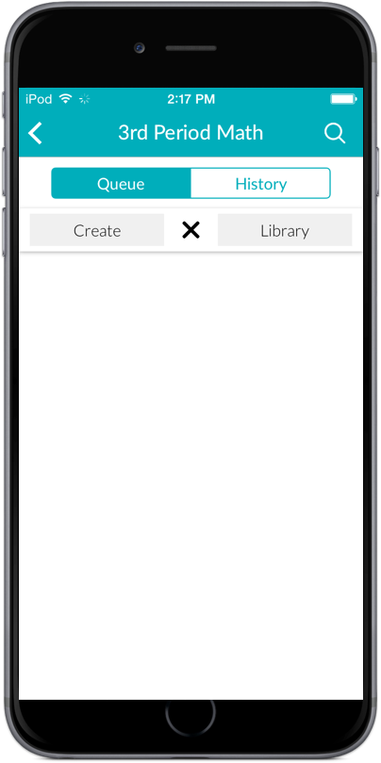
Add Your Questions
Create new questions in your Library on the web or on your mobile app using the “+” icon.
Choose from multiple choice or true/false questions.
Include images in your questions.

Slide 14
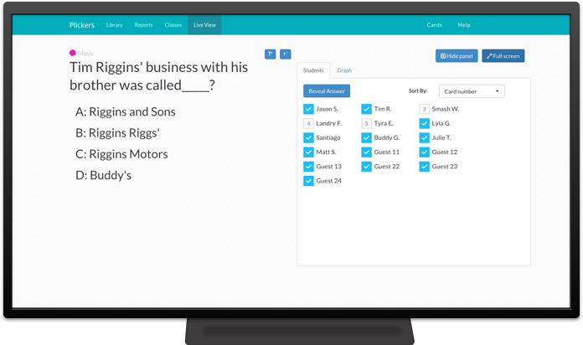
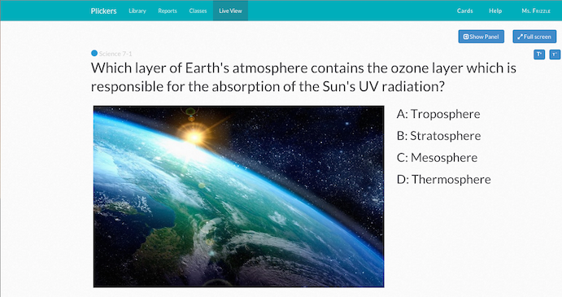
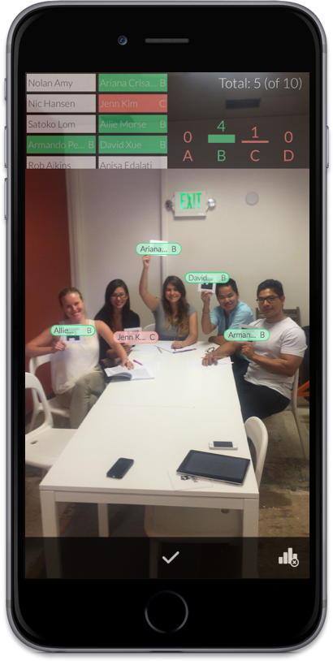
Scan Responses

Slide 15
Scan Responses
Select the question you want to use on the mobile app.
Tap the camera icon to scan students’ responses and receive instant feedback on their answers.
Use the Live View tab on the website to display classroom results to students.

Slide 16
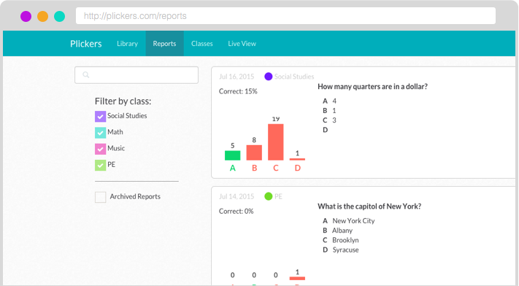
View Results

Slide 17
View Results
Share real-time results with the whole class by projecting the Live View tab.
Review all your results on the Reports page to identify concepts to review and celebrate skills mastered.

Slide 18
Resources
http://plickers.com/help
help@plickers.com
Twitter - @plickers
Suggestions - https://plickers.uservoice.com/

